Slide 1
Manifest Templating

Slide 2


Organization
-IT
6000-ish employees
140+ companies*

Slide 3


Organization
-IT
6000-ish employees
140+ companies*

Slide 4


Cluster management
-IT

Slide 5




Abstraction layers
Our Developers
kubectl
Our Developers

Slide 6
Deploying workload

Slide 7



Potential tools
kro

Slide 8

Potential tools
kro
❌ Kustomize: Requires too much Kubernetes knowledge to write overlays/extend, does not scale well overall, and requires knowledge of the base/template in order to extend it.
❌ Kro: Very immature and does not support basic functionality.

Slide 9
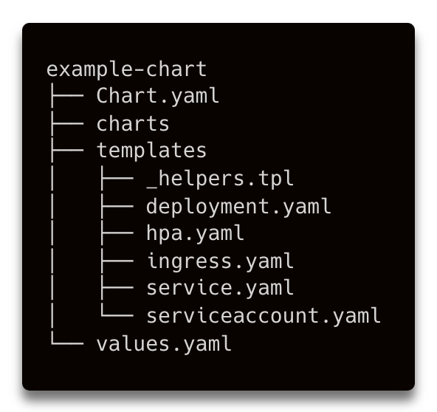
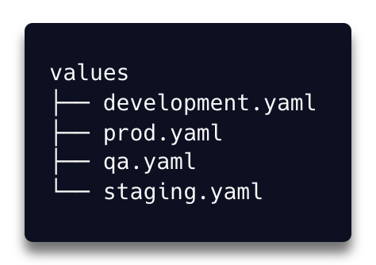
Helm

Slide 10
Crossplane
Managed Resources
Compositions

Slide 11
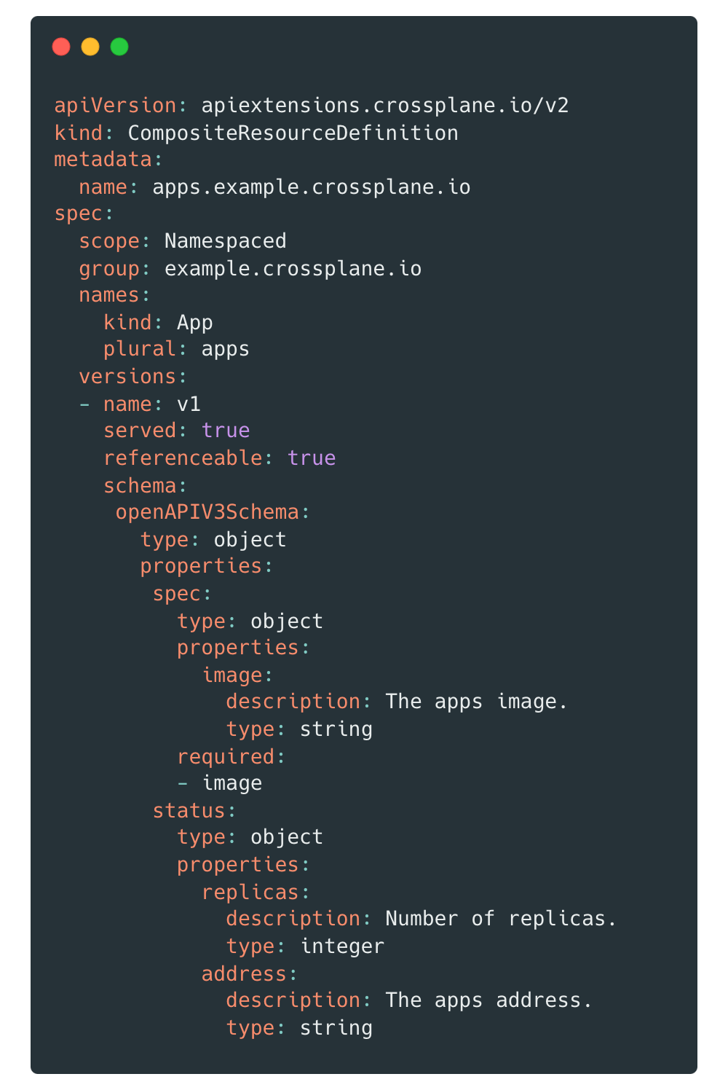
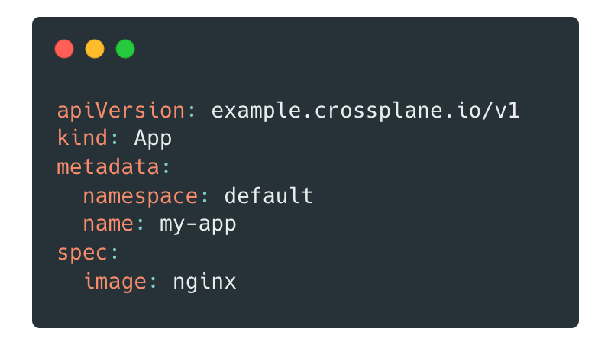
Crossplane
Compositions

Slide 12
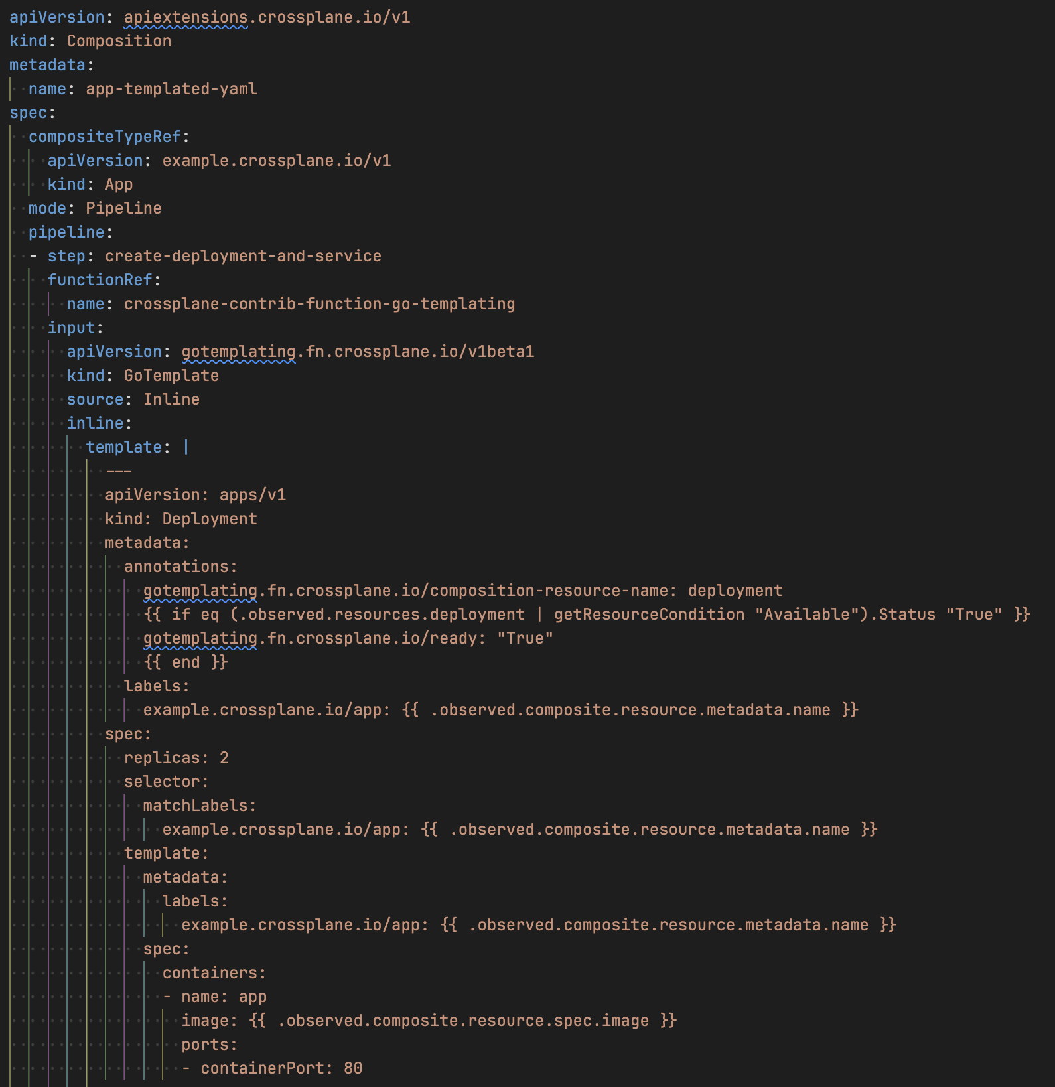
Crossplane
Compositions

Slide 13
Crossplane selling points
Stronger contract
Schema-validated Application definitions from the developers. Kubernetes (via admission webhooks) will block their resources if they are invalid (in most cases).
Invisible updates:
We (the platform team) can update the underlying template without needing to adjust the Application definitions or bump a version on the developer side.

Slide 14
Local Rendering

Slide 15
Local rendering
helm template . -f values.yaml
kustomize build ./overlays/production
crossplane render -r --include-context my-resource.yaml composition.yaml functions.yaml --extra-resources environmentconfig.yaml
requires running containers (if you use functions)
Kro … well no that doesn't work.

Slide 16
Previewability

Slide 17

Cluster Insight
Check workload
Metrics
kubectl
(if they request it)

Slide 18
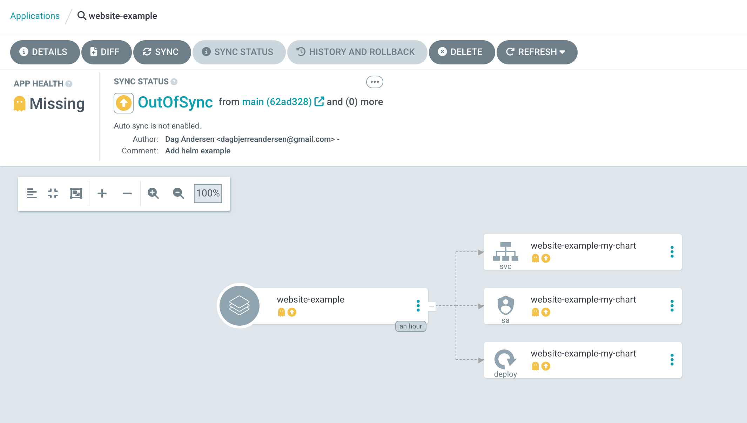
Previewability

Slide 19
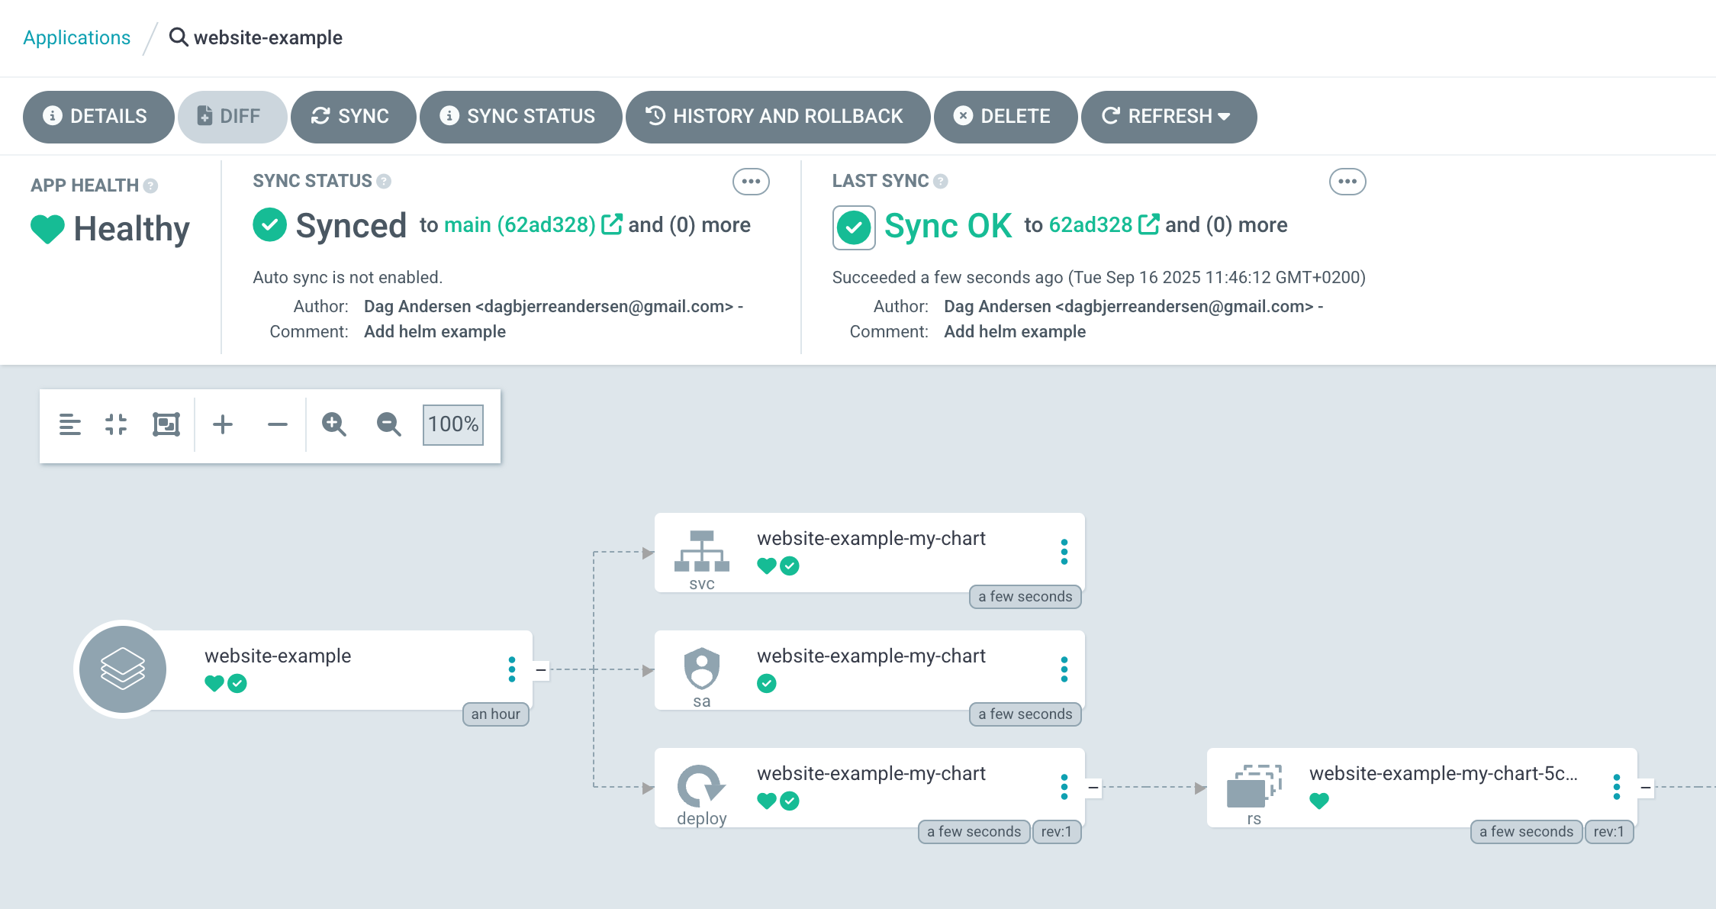
Previewability

Slide 20
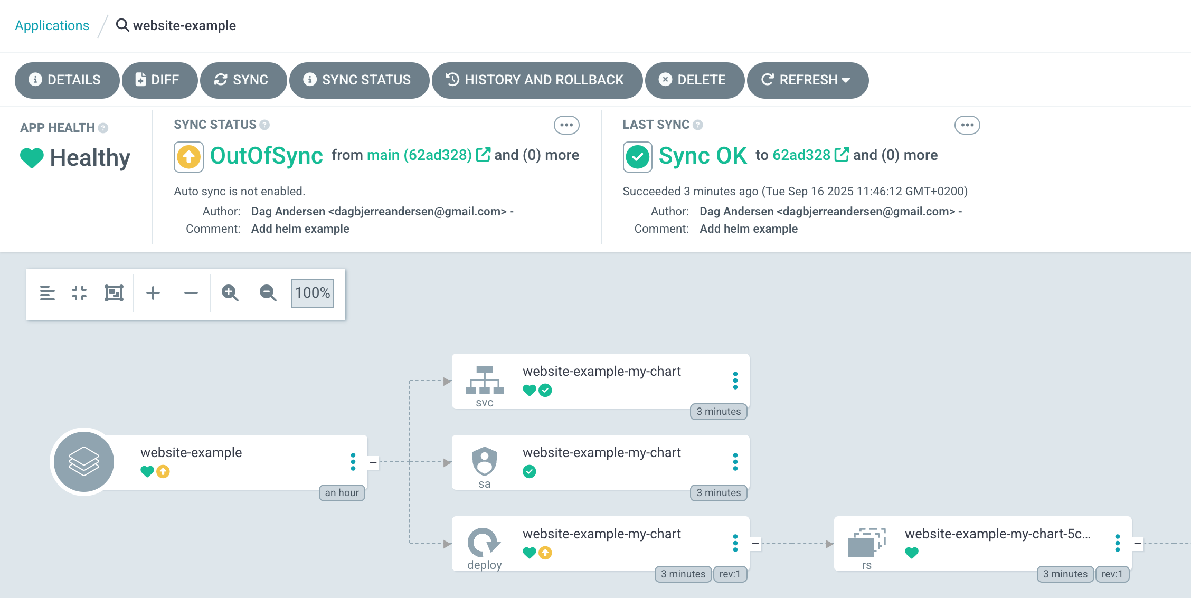
Previewability

Slide 21
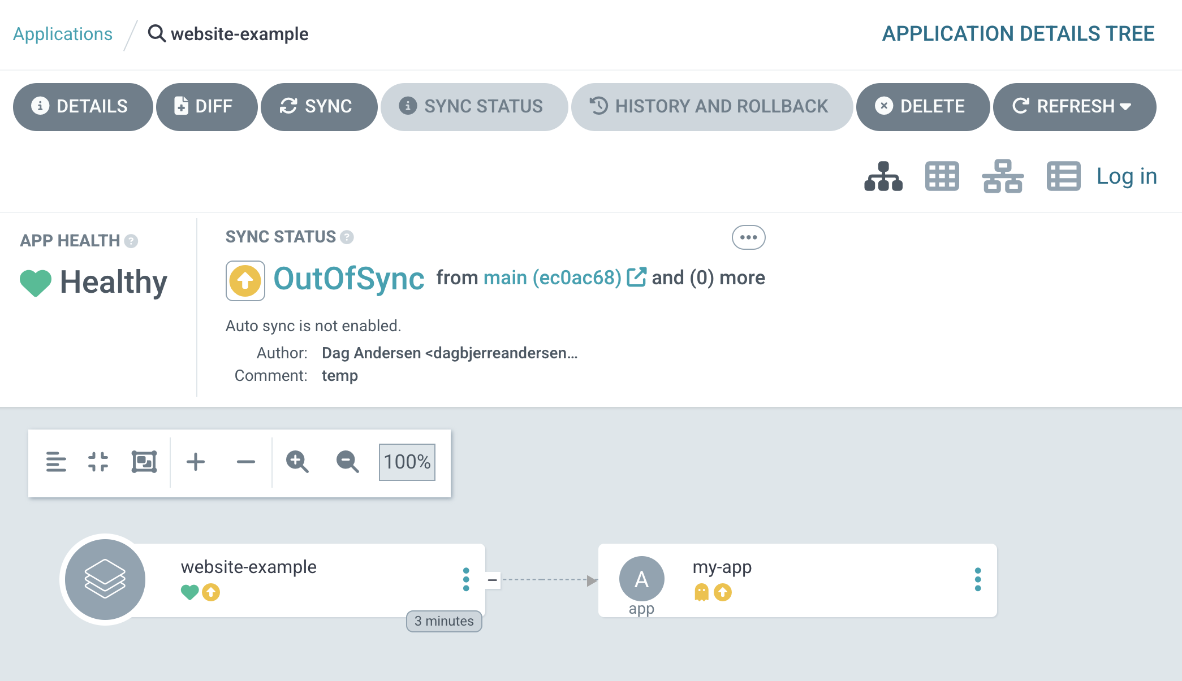
Previewability

Slide 22
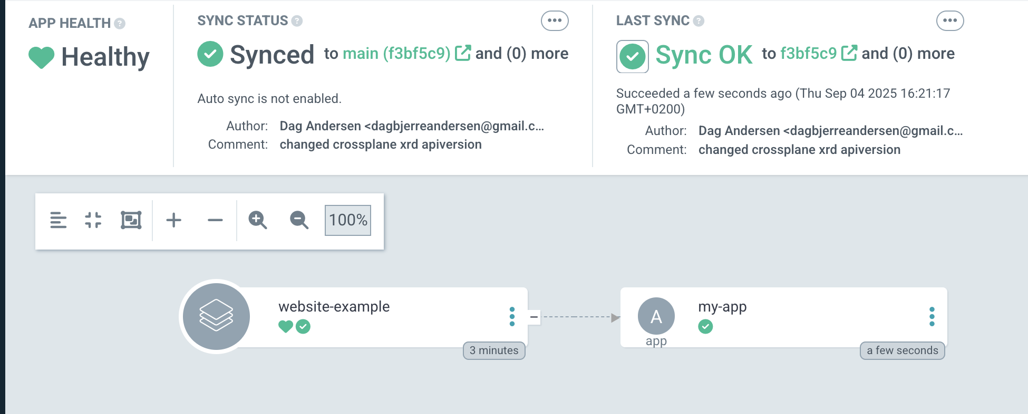
Previewability
After we sync – everything looks good, but nothing is happening

Slide 23
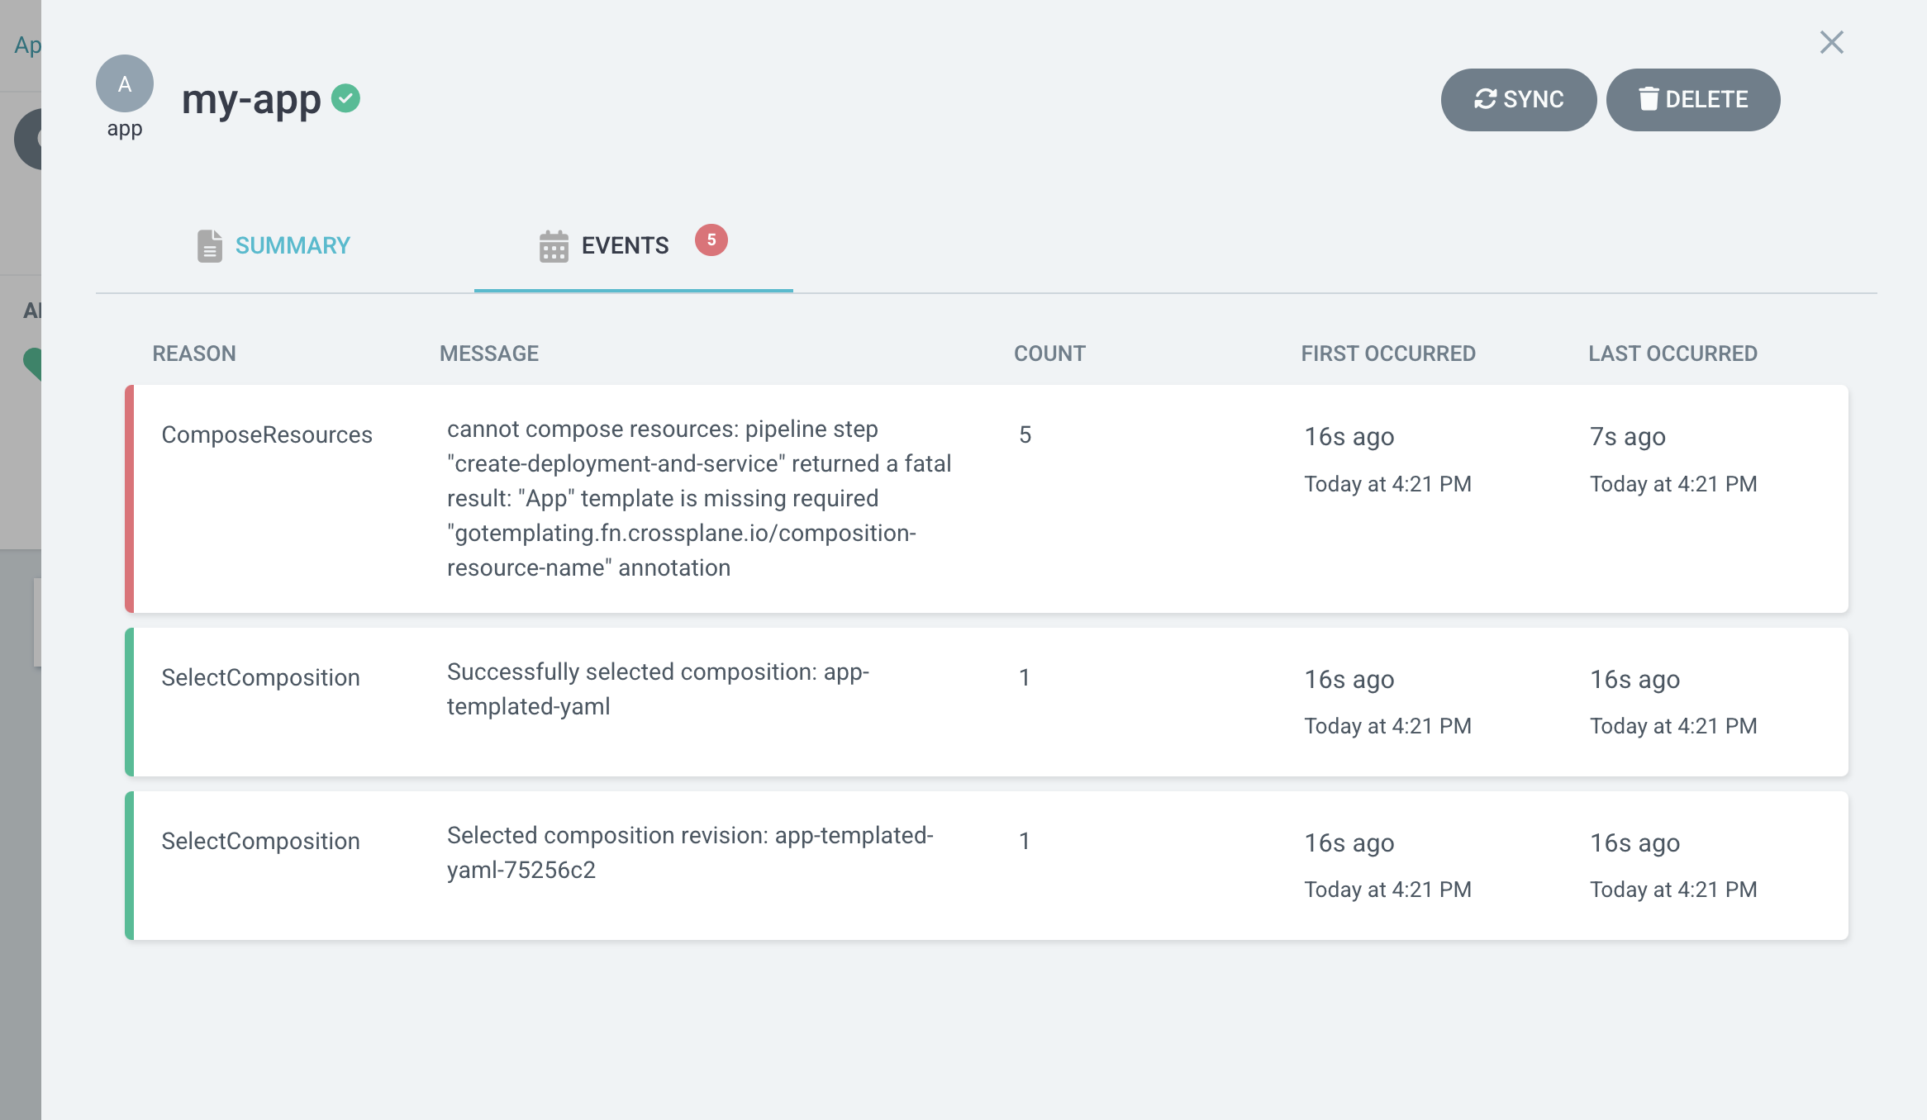
Previewability
Now we see it is broken

Slide 24
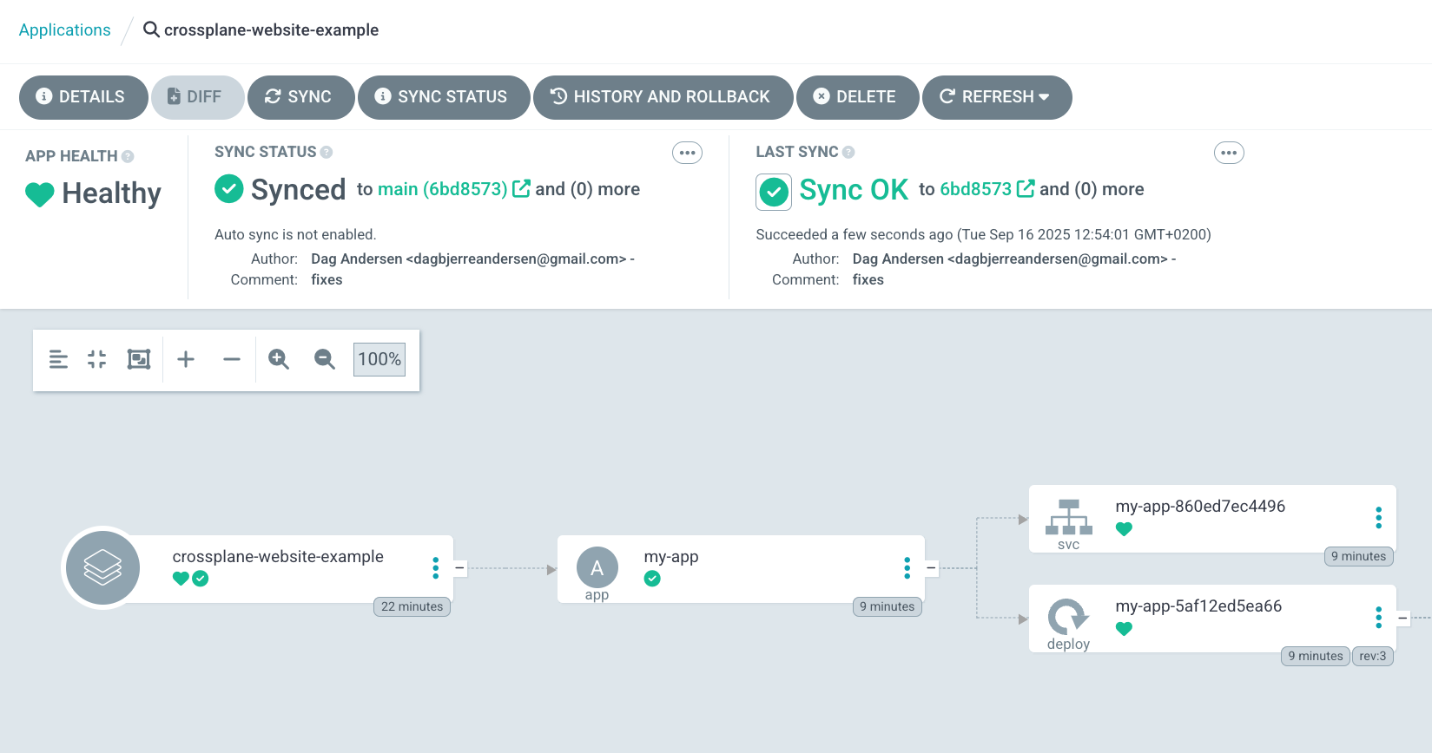
Previewability
After fixing the problem, Crossplane will generate the new resources

Slide 25
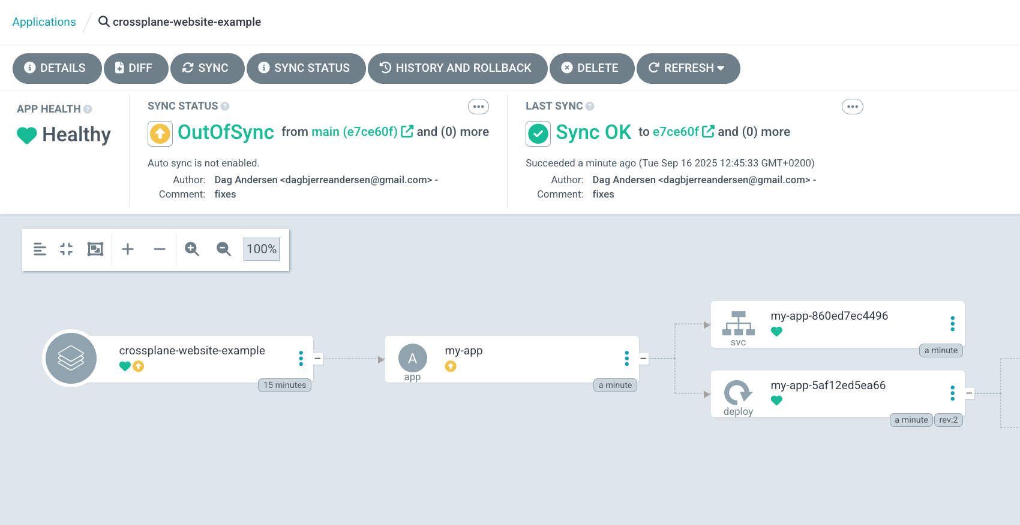
Previewability

Slide 26
Health Checks

Slide 27
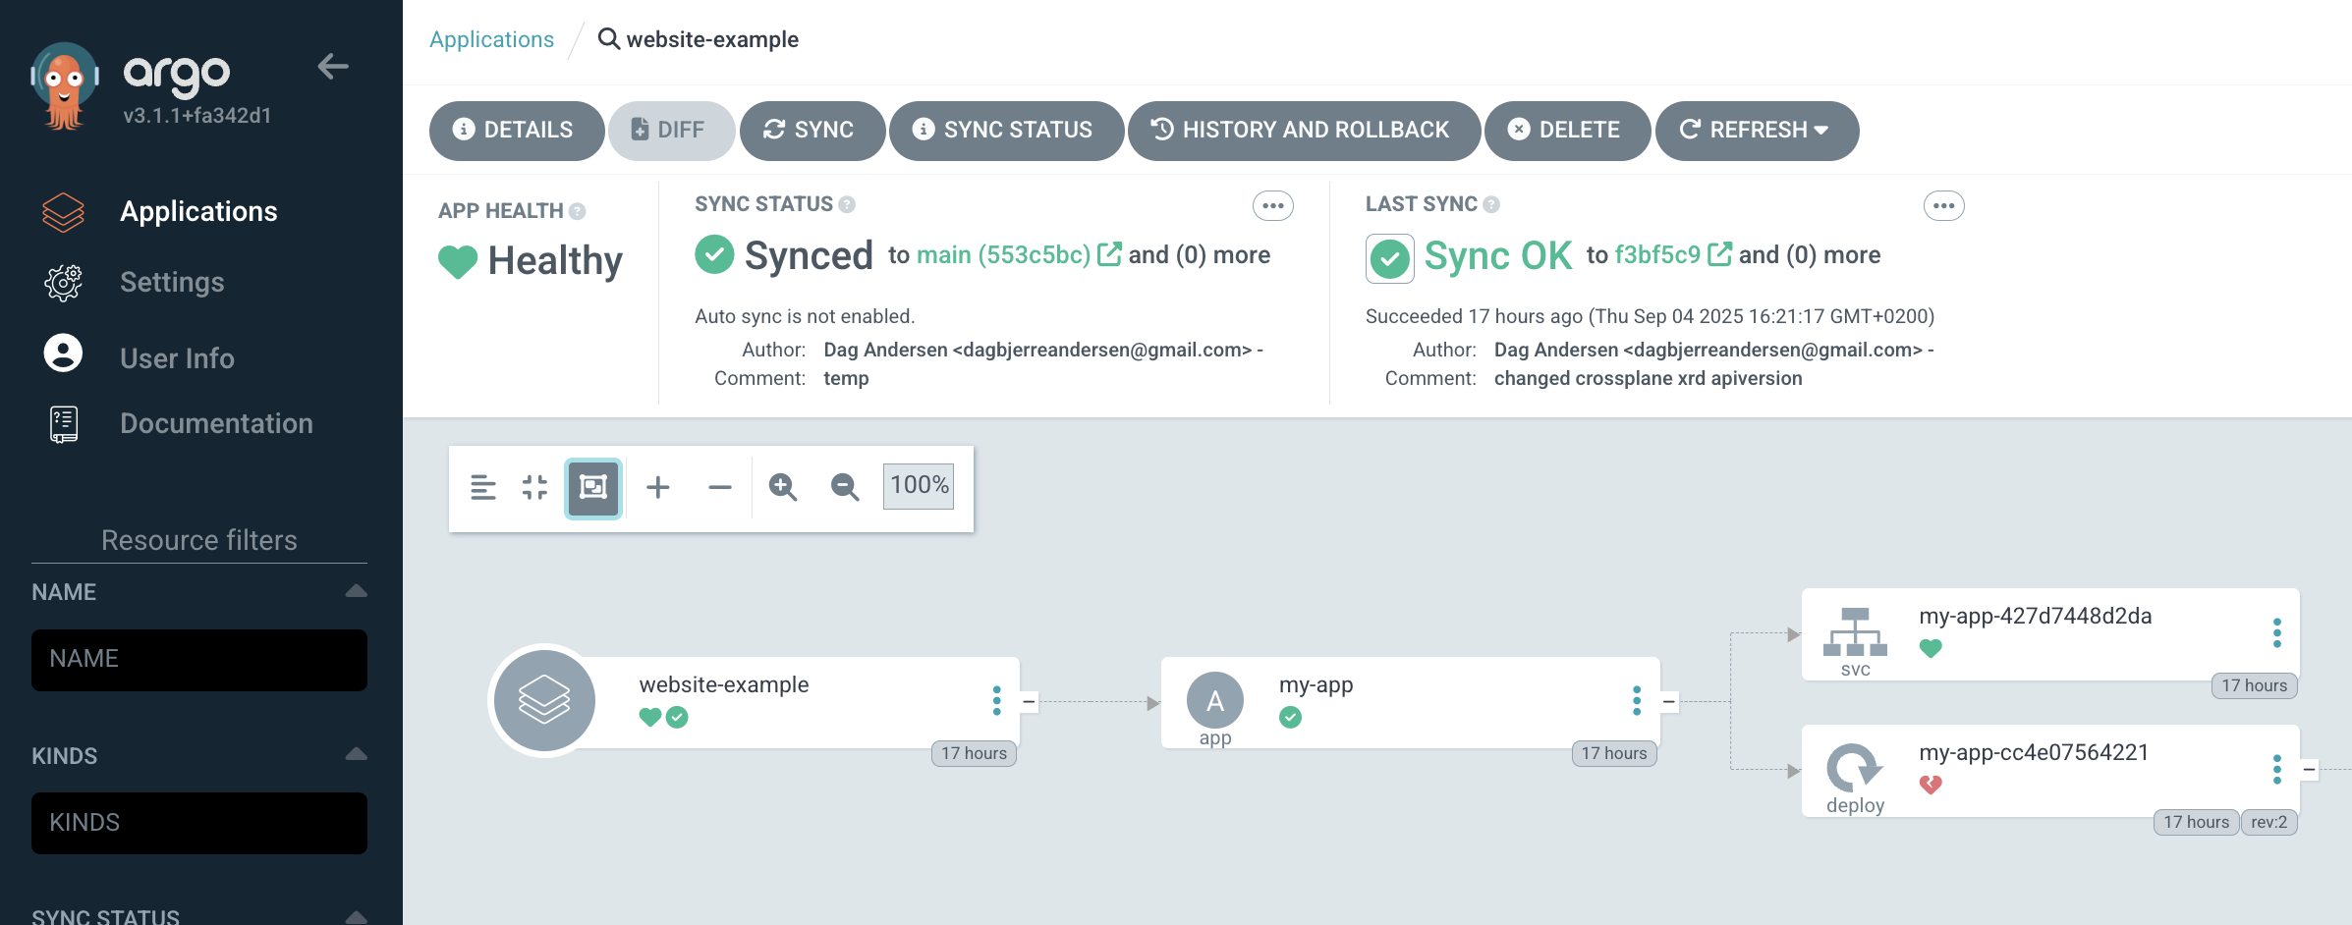


Previewability

Slide 28
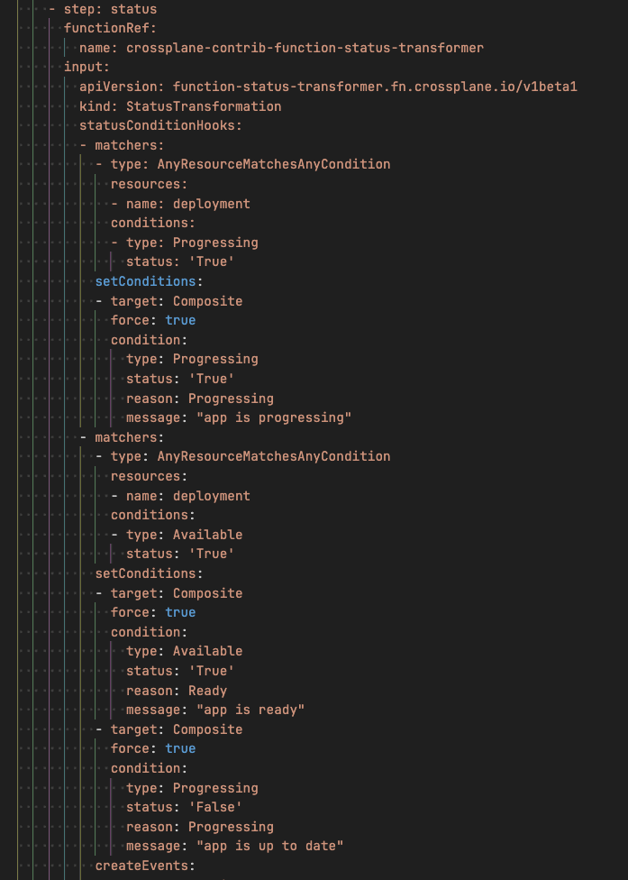

Previewability

Slide 29
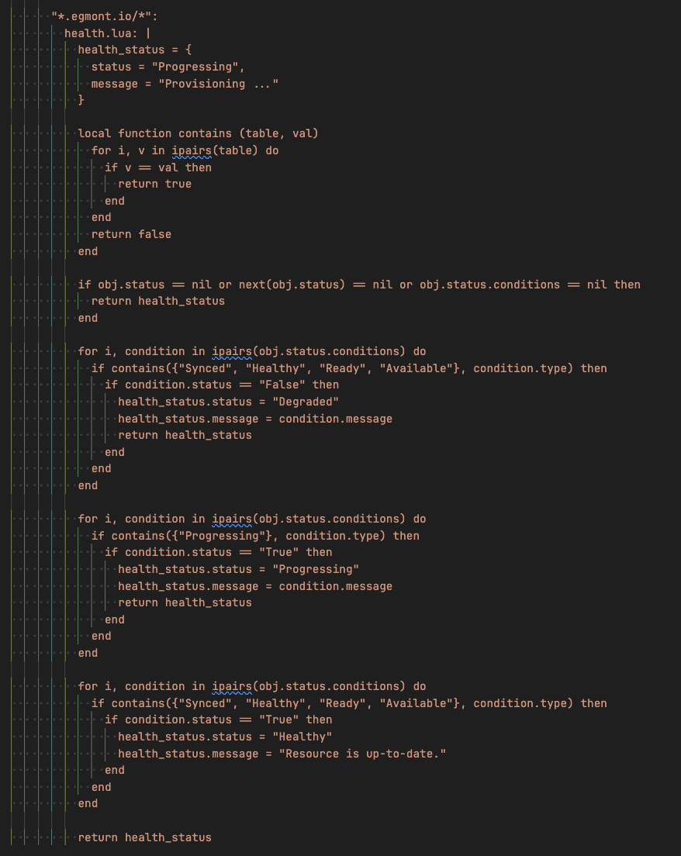
Previewability

Slide 30
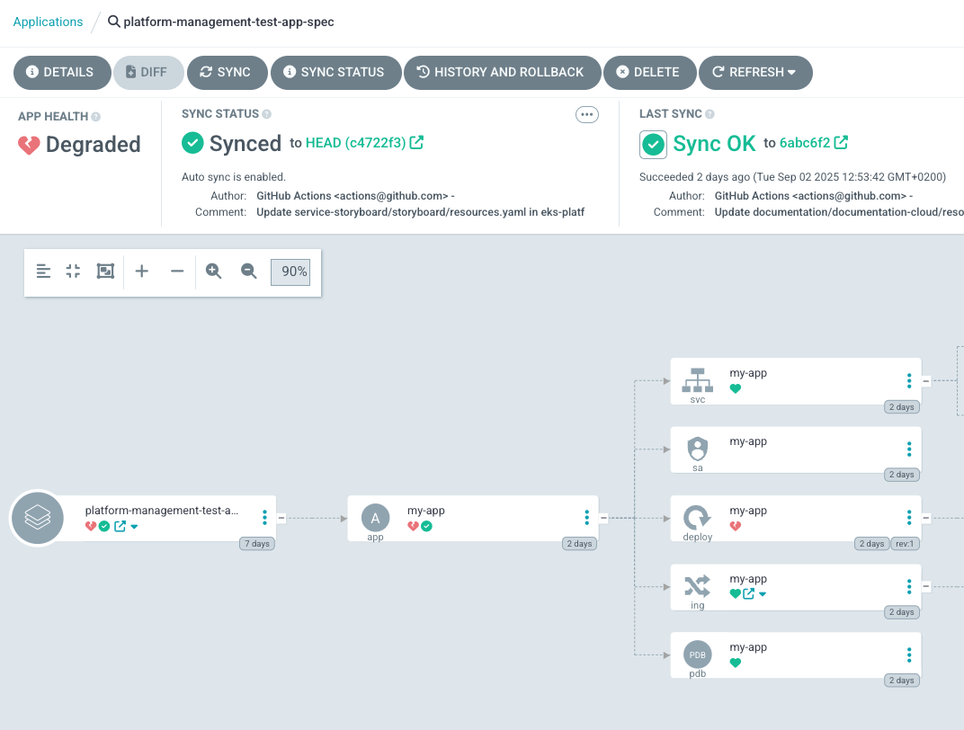




Health Checks

Slide 31
Overall complexity

Slide 32
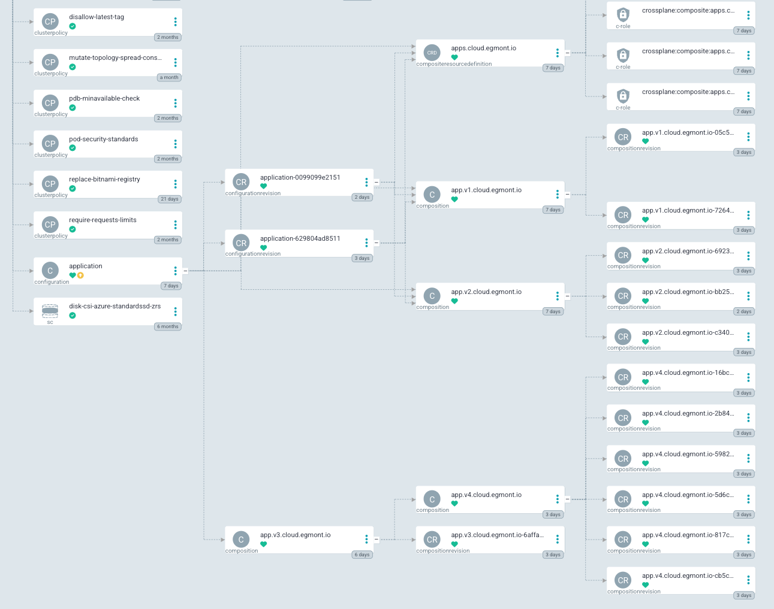
Crossplane complexity
Suddenly you’re juggling: - Configurations
- configurationRevisions
- Compositions
- CompositionsRevisions
- Functions (that requires running pods)

Slide 33
What Argo CD is basically doing:
Helm template [...] –f values.yaml | kubectl apply –f -
kustomize build ./overlays/production | kubectl apply –f -

Slide 34
Updating Critical components

Slide 35
Cluster management
-IT

Slide 36
Cluster management
-IT
🔥
🔥
🔥
🔥
🔥
🔥

Slide 37
Updating critical components when using helm
Local rendering with `helm template`
⬇️
Helm rendering in GitHub pipeline
⬇️
Disabled auto-sync and verify changes in UI
⬇️
Re-enable auto-sync so it deploys automatically

Slide 38
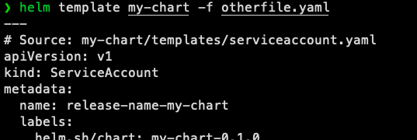
Updating critical components when using helm
Local rendering with `helm template`
⬇️
Helm rendering in GitHub pipeline
⬇️
Disabled auto-sync and verify changes in UI
⬇️
Re-enable auto-sync so it deploys automatically

Slide 39
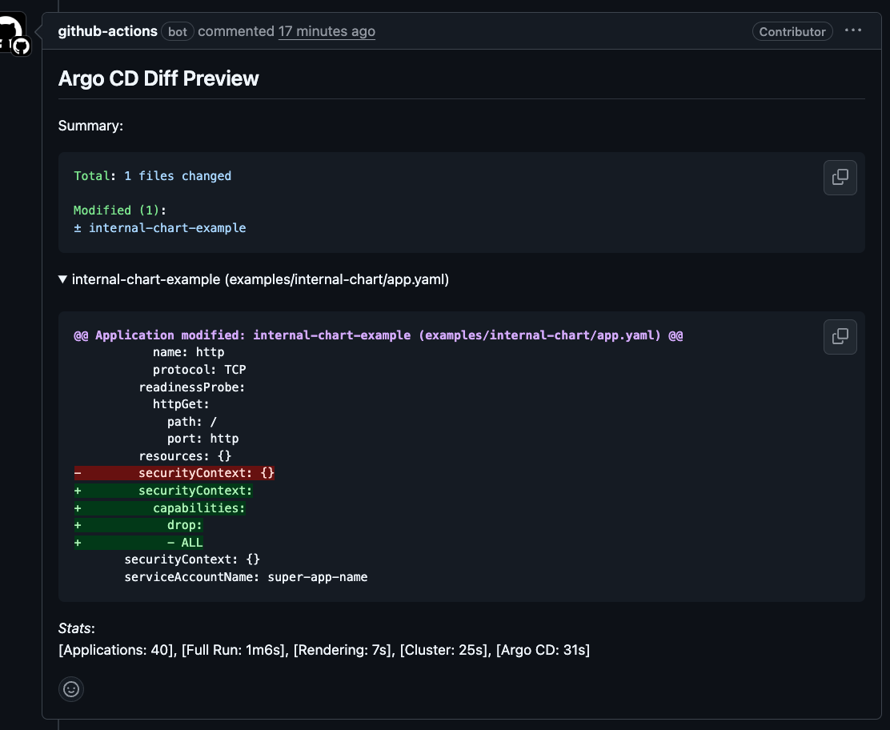
Updating critical components when using helm
Local rendering with `helm template`
⬇️
Helm rendering in GitHub pipeline
⬇️
Disabled auto-sync and verify changes in UI
⬇️
Re-enable auto-sync so it deploys automatically

Slide 40
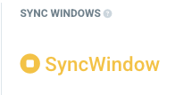
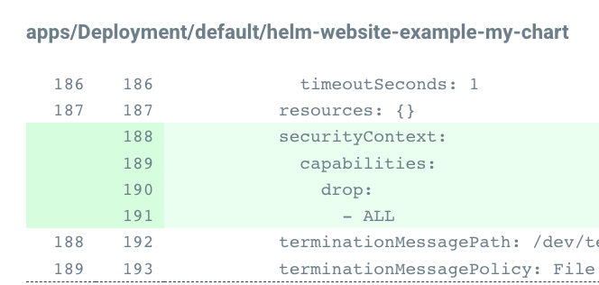
Updating critical components when using helm
Local rendering with `helm template`
⬇️
Helm rendering in GitHub pipeline
⬇️
Disabled auto-sync and verify changes in UI
⬇️
Re-enable auto-sync so it deploys automatically

Slide 41
Updating critical components when using helm
Local rendering with `helm template`
⬇️
Helm rendering in GitHub pipeline
⬇️
Disabled auto-sync and verify changes in UI
⬇️
Re-enable auto-sync so it deploys automatically

Slide 42
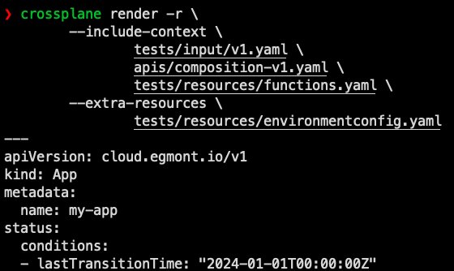
Updating critical components when using Crossplane
Local rendering with `crossplane render`
⬇️
Yolo merge and pray 🙏 🙏 🙏🥺🥺🥺
Where is my preview???

Slide 43
Questions?

Slide 44

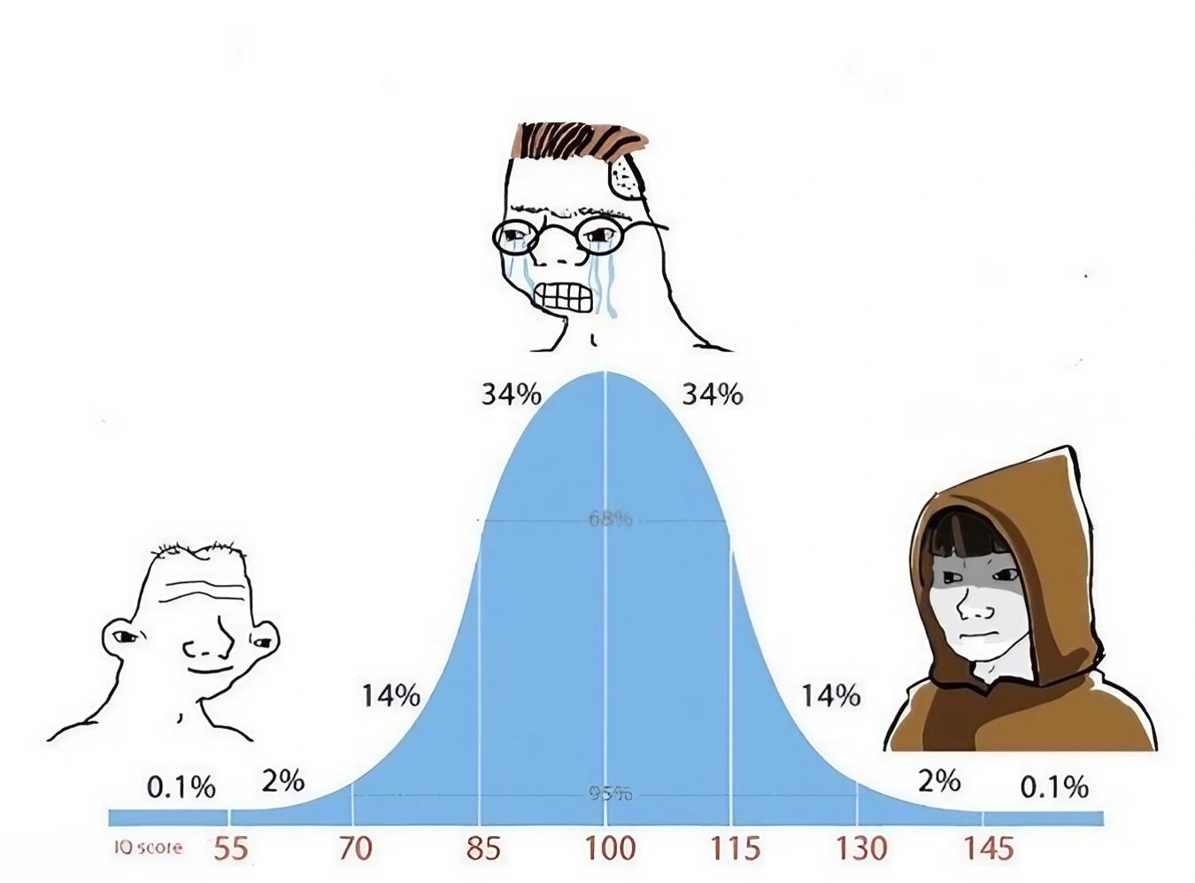
Questions
Does the value of Crossplane justify the added complexity?
How do you validate your changes before they go into production?
What templating tools do you use in your company?
Crossplane
Helm
Helm

Slide 45
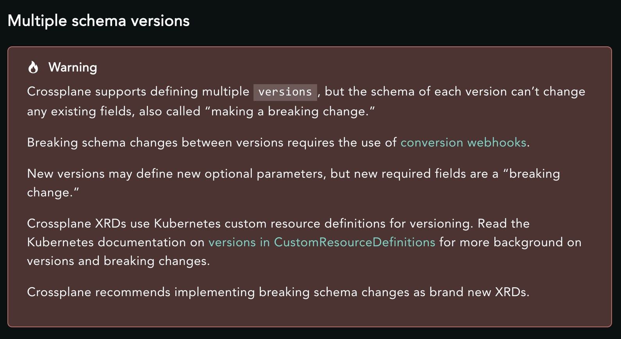

Slide 46
Welcome to the Egmont presentation template!
This template is your go-to tool for creating on-brand presentations. The following slides in this deck provide guidelines as well as examples of how to use the template layouts. Enjoy!
Find more brand guidelines on https://brandcenter.egmont.com/

Slide 47
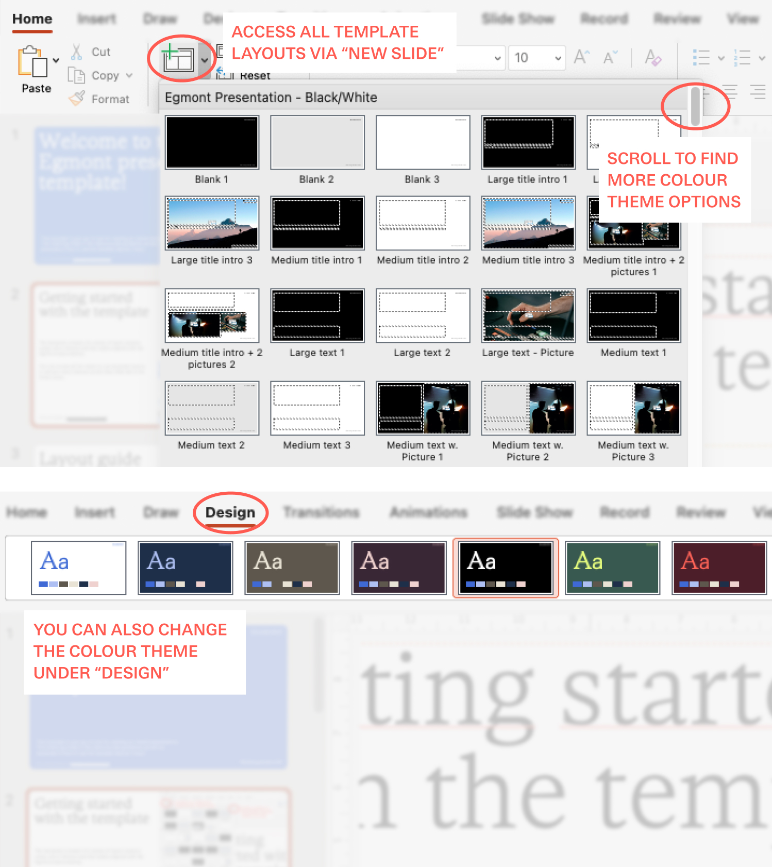

Getting started with the template
The template consists of a variety of layout options using colour themes and text styles aligned with the Egmont brand identity.
You can access all the ready-to-use template layouts in various colour themes via the New Slide or Design tab in the Home menu.
Find more colour guidelines on https://brandcenter.egmont.com/colours

Slide 48
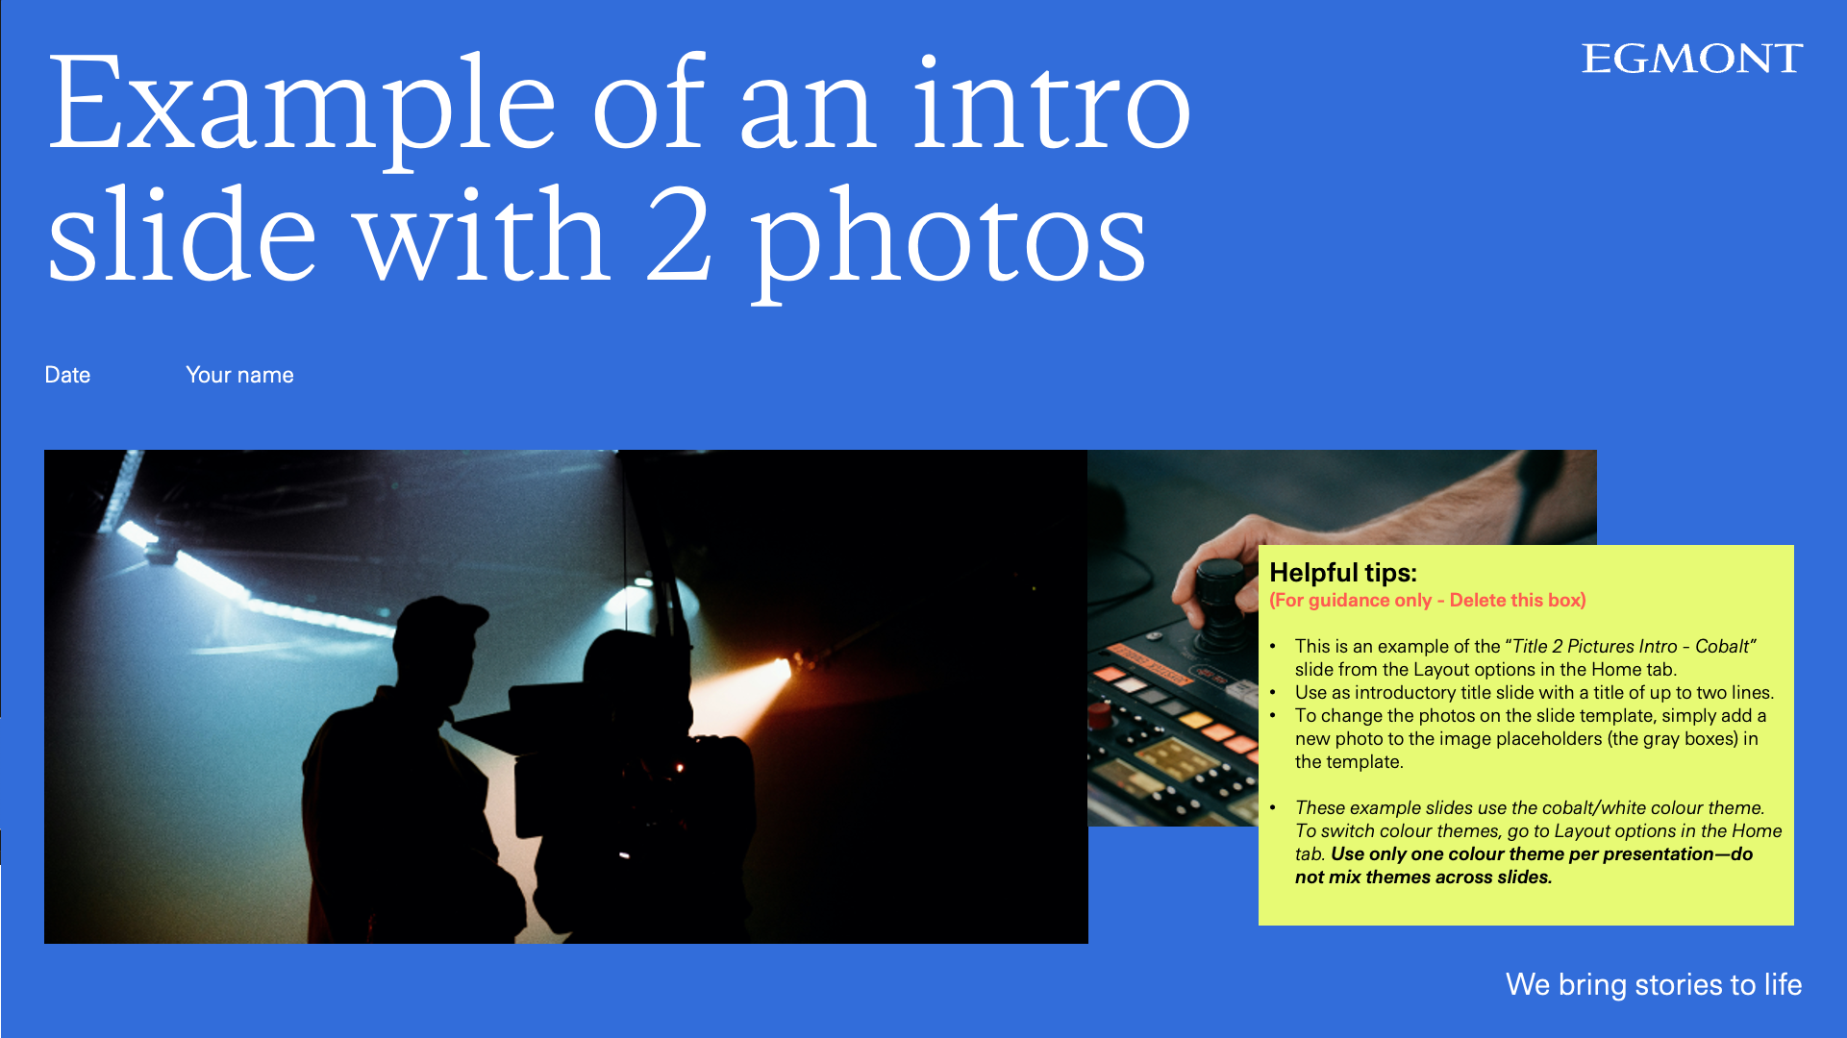
Layout guide
This template provides a variety of slide layouts to help you create the presentation you need. In this deck, the layouts are filled out with examples to demonstrate how to use the text and image fields.
The yellow 'Helpful Tips' boxes are included to guide you. Be sure to delete them before finalising your presentation.
Some general helpful tips for layouts:
Keep it simple! Avoid overcrowding slides with too much text and too many images at once.
Keep it short! Use concise titles and avoid lengthy lines of text.
Stick to the template presets! Use the preset text sizes and avoid introducing additional text styles.
Find more colour guidelines on https://brandcenter.egmont.com/composition

Slide 49
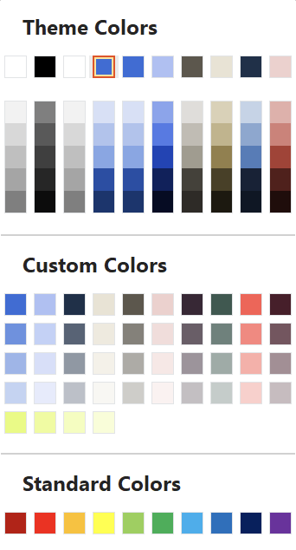
Colour guide
Egmont graph colours are used automatically.
Do not use PowerPoint tint colours
Our colour palette contains seven fixed colour pairs, each with a light and dark toned colour designed to be used interchangeably. The pairs are made to ensure legibility and to create a design system that is easy to work with. The colours should be used in the pairs shown here and never mixed.
Egmont Custom Brand Colours can be used throughout the presentation.
Do not use PowerPoint Standard colours.
Find more colour guidelines on https://brandcenter.egmont.com/colours

Slide 50
Colour guide
The Egmont brand offers seven colour themes to choose from, all of which are available in this template. You can access them through the Design option or under New Slide in the Home menu (read more about colours on page 4).
The most important rule: stick to one colour theme throughout your entire presentation!
For example, if you choose the Cobalt/White theme, ensure all slides use the same Cobalt/White theme consistently.
All colour themes also provide the option of a blank white background with a coloured logo and payoff.
Find more colour guidelines on https://brandcenter.egmont.com/colours

Slide 51
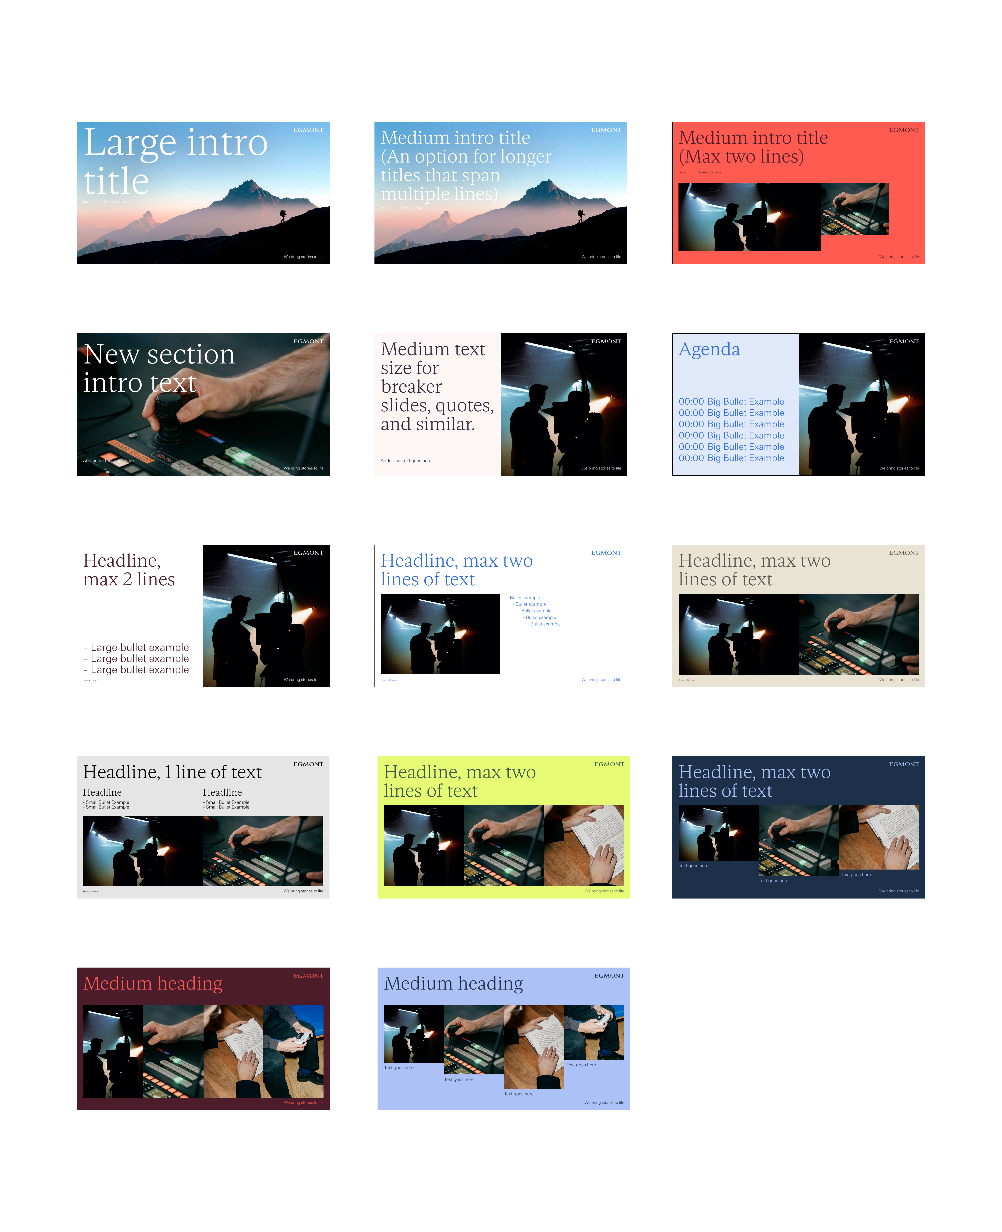
Image guide
Using images in your presentation can enhances your presentation's visual impact and engagement. This approach helps break up text-heavy slides, making your presentation more enjoyable and easier to follow.
Choose relevant images that support your content and ensure they are high quality. We've included example photos on the slides to demonstrate how the slides can look. You can change the image by clicking on the icon on the placeholder image.
Find more icon guidelines on https://brandcenter.egmont.com/imagery

Slide 52






















































Icons
Icons can help make your slides clearer and more visually engaging. Use them to highlight key points, represent ideas, or break up text-heavy slides.
To use an icon, simply copy-paste one from the selection on the right.
General rules for icon use:
Keep it simple: use icons sparingly and ensure they align with the overall message of your slide.
Keep all icons on a slide the same size and avoid mixing different sizes.
Use only the colours from you selected colour theme. Don’t mix and match colours from different themes. (See more colour guidelines on page 4-5).
How to change the icon colour:
Click on an icon → Go to the Graphics Format menu → Select Graphics Fill → Choose a colour from your presentation’s selected colour theme.
Find more icons and icon guidelines on https://brandcenter.egmont.com/icons

Slide 53
Infographics
Infographics make it simpler for the viewer to understand and remember the information by presenting it clearly and visually. You can highlight important information, show differences in data, and help guide the viewer through your content easily.
General rules for infographics use:
Keep It Simple: Use clear visuals and minimal text to make the information easy to grasp quickly.
Be Consistent: Stick to one style of graphics and the Egmont colour pairs to maintain visual harmony.
Focus on Data: Highlight key points and organize data logically.
Brandcenter.egmont.com

Slide 54
Example of a longer title that requires multiple lines to fit all the text properly.
Date
Your name
Helpful tips:
(For guidance only - Delete this box)
This is an example of the “Long Title Intro - Cobalt” slide from the Layout options in the Home tab.
These example slides use the cobalt/white colour theme. To switch colour themes, go to Layout options or Design in the Home tab. Use only one colour theme per presentation—do not mix themes across slides.

Slide 55
Intro slide example
Date
Your name
Helpful tips:
(For guidance only - Delete this box)
This is an example of the “Big Title Intro – Picture” slide from the Layout options in the Home tab.
Use as introductory slide with a short presentation title
Avoid a long title for this slide (there are other options for title slides with longer titles)
To change the photo on the “Big Title Intro – Picture” slide, simply add a new photo to the image placeholder (the large gray box) in the template.

Slide 56
Example of an intro slide with 2 photos
Date
Your name
Helpful tips:
(For guidance only - Delete this box)
This is an example of the “Title 2 Pictures Intro - Cobalt” slide from the Layout options in the Home tab.
Use as introductory title slide with a title of up to two lines.
To change the photos on the slide template, simply add a new photo to the image placeholders (the gray boxes) in the template.
These example slides use the cobalt/white colour theme. To switch colour themes, go to Layout options or Design in the Home tab. Use only one colour theme per presentation—do not mix themes across slides.

Slide 57
Example of a breaker slide with a title
Helpful tips:
(For guidance only - Delete this box)
This is an example of the “Medium text” slide from the Layout options in the Home tab.
Use as introductory title slide with a title of up to tree lines.
You can add extra information in the body text box.
These example slides use the cobalt/white colour theme. To switch colour themes, go to Layout options or Design in the Home tab. Use only one colour theme per presentation—do not mix themes across slides.
Here you can add extra information on the breaker slide.

Slide 58
Agenda example
08:30
09:00
10:00
12:30
15:00
Introduction
Agenda for the day
Presentation
Workshop session
Thanks for today!
Helpful tips:
(For guidance only - Delete this box)
This is an example of the “Agenda slide” slide from the Layout options in the Home tab.
Use as an agenda slide with a short.
You can add all your agenda information in the body text and add timestamps for the meeting.
These example slides use the cobalt/white colour theme. To switch colour themes, go to Layout options or Design in the Home tab. Use only one colour theme per presentation—do not mix themes across slides.

Slide 59
dfdfdfd

Slide 61
dfdfdfd

Slide 64
We bring stories to life

Slide 91


Slide 99


Slide 101


